Slide 1
ASP.NET Core: What you need to know
Spencer Schneidenbach

Slide 2

About Me
Platform Architect at Ryvit
Consultant
Web developer
AngularJS 1/2, ASP.NET, C#
Twitter: @schneidenbach
Github: schneidenbach
Email: sas.projects@me.com
Website: schneids.net

Slide 3
ASP.NET Core Goals
Aims to be the best web stack for any platform
Host agnostic
Provide cross-platform development experience
Faster, more scalable than current ASP.NET
System.Web requests take ~30kb of memory per request
ASP.NET Core – around ~2kb

Slide 4
ASP.NET Core in Production
Go-live license released with RC1
RC2 came out and broke more stuff
Entire demos were broken
Slide decks were made obsolete
…including mine

Slide 5
Let’s talk .NET Framework
.NET Core – open source, lightweight subset of .NET Framework
Needed components delivered via NuGet
More iterative updates
Deployed with your app
Aims to be pure re-implementation of .NET Framework…someday
Cross-platform
.NET Framework
You can still use full .NET Framework if you need stuff like System.Drawing or other full-framework specific libraries
Requires Windows

Slide 6
The times, they are a’changing’ ASP.NET Core Current ASP.NET
What’s The Same
What’s Different
C#
.NET Framework
No VB.NET
No Web Forms
.NET Core
Roslyn compiler
Cross-platform
Slightly different APIs
No Web.config
No Global.asax
No dependency on MSBuild

Slide 7
Web Forms
Web Forms isn’t a technology in ASP.NET Core
It’s still being updated and supported
Still needs System.Web
Still needs IIS
Still needs Visual Studio

Slide 8
Current MVC 5/Web API 2 Apps
No direct upgrade path
Create new project and copy over code
APIs between the two differ slightly
Otherwise, it’s a very familiar experience

Slide 9
ASP.NET Core Toolchain
NPM/Node
Bower
Grunt/Gulp
dotnet CLI

Slide 10
NPM/Node
NPM stands for Node Package Manager
Pretty much like Nuget
Uses package.json
Manages the packages your project needs

Slide 11
Bower
YOU DON’T NEED IT
Client-side package manager
But guess what?

Slide 12
npm can take care of you
Can install client side dependencies as well!

Slide 13
Grunt/Gulp
Task runners
Do stuff like:
Minify CSS and JS
Run tests
Move files around
But guess what?
YOU (probably) DON’T NEED IT

Slide 14
npm can take care of you
Can run tasks as well!
If you like gulp, then use it!

Slide 15
dotnet command line interface
Build and run your code
Restores dependencies from project.json

Slide 16
Let’s go over the project structure
wwwroot
project.json
Startup.cs
Program.cs
Models
Controllers
Views

Slide 17
wwwroot
Where all static files go
No longer mixed into the root of the project
A welcome change!

Slide 18
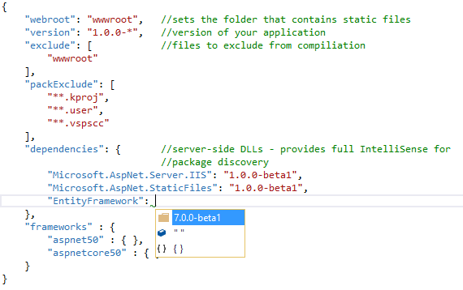
project.json
Replaces packages.config
General project configuration
Server-side dependencies
MSBuild

Slide 20
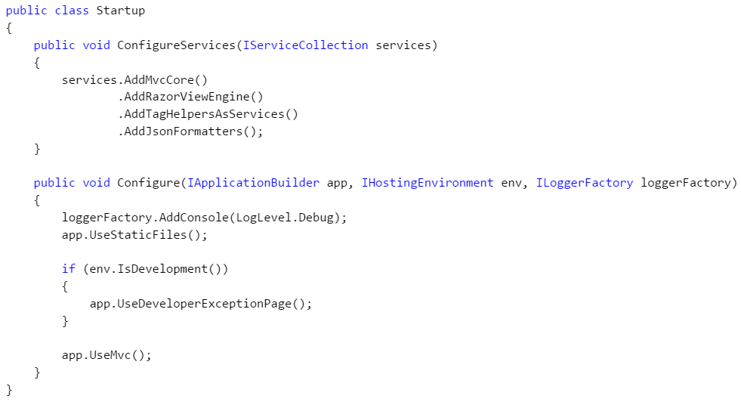
Startup.cs
Where services are registered and the application is configured

Slide 21
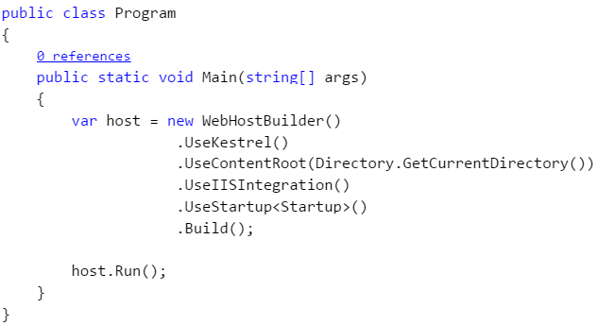
Program.cs
Unlike ASP.NET 4.6 apps, ASP.NET Core has a Main method!

Slide 22
Models
Where your ViewModels and DTOs live
Your domain objects should live elsewhere
But that’s another show

Slide 23
Controllers
Controllers are your main interface with the outside world
They are the traffic cops of your web app

Slide 24
Views
Views are returned from controllers
Can have a layout view (kinda like a site.master)

Slide 25
Tooling demo

